Slide 1
Alcohol and Accident Detection System

Slide 2
GROUP MEMBERS
SAI TEJA BANDARU - 20BRS1129
SHRIKRISH S - 20BRS1190
SAI VIGNESH N - 20BCE1128

Slide 3
ABSTRACT
As the usage of vehicles is increasing drastically, the hazards due to vehicles has also increased. The main cause for accidents is high speed, drunk and drive, diverting minds, over stress and due to electronic gadgets. In most cases, when an accident happens, it takes a lot of time for the families of the injured person receive the news of the accident.
Our system senses the vehicle and whenever if either the driver is drunk or doesn’t wear seatbelt, he/she gets indication through beep sounds. Also our system detects accidents, gets the location of the vehicle at accident spot, and a message requesting aid will be forwarded to the rescue team whose mobile number is registered in GSM.
The main objective of our project is to protect the lives of human beings by introducing an accident alerting and reporting system to not only minimize the number of accidents by alerting the driver but also to provide quick assistance in case an accident occurs.

Slide 4
COMPONENTS REQUIRED(Hardware and software)
SOFTWARE:
The proposed system can designed and simulated in the simulation software Proteus Professional 8. For coding Arduino 1.65 ® can be used.
HARDWARE:
Arduino Uno ATmega328 microcontroller
MQ-3 Alcohol sensor
LCD
IR Sensor(Seat Belt Sensor)
Buzzer
GSM Module
GPS Module
DC Motor
Vibration Sensor(Accident sensor)

Slide 5
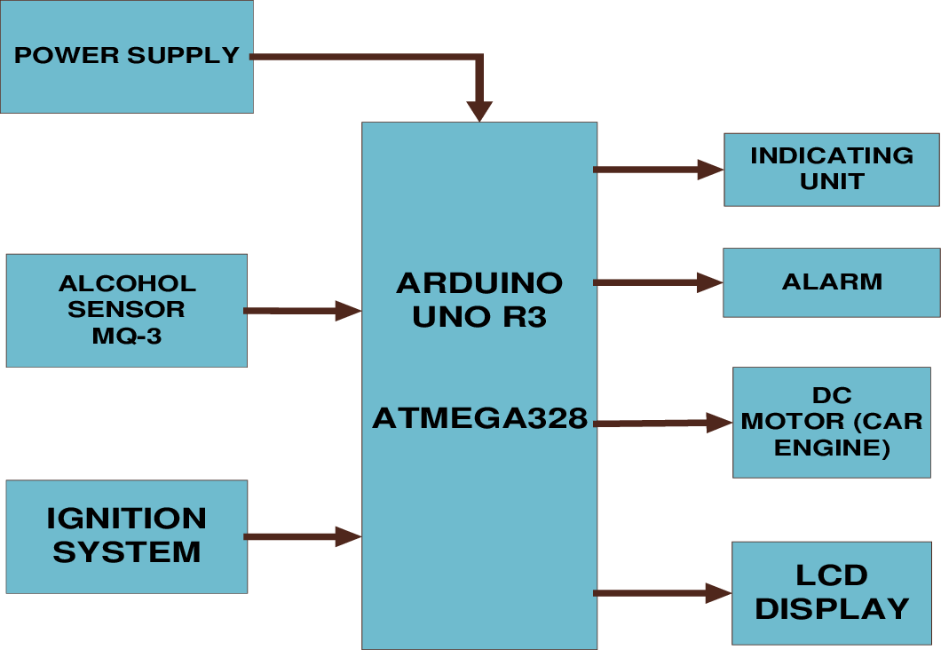
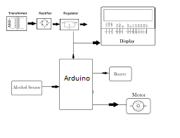
WORKING PRINCIPLE
The Alcohol Detection with Engine Locking system helps to reduce accidents which are occurring due to drunk driving. Alcohol sensor detects the presence of alcohol in the surroundings.
The sensor provides output on the basis of the concentration of the alcohol, if the alcohol concentration is higher the conductivity of alcohol sensor increases which in turn gives the reading to ARDUINO.
If the reading is greater than the threshold level, ARDUINO will stop the DC motor(car), the buzzer is turned on and message is displayed on LCD.

Slide 6
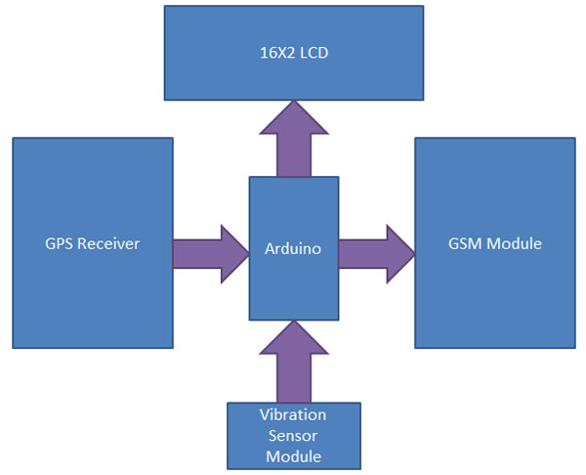
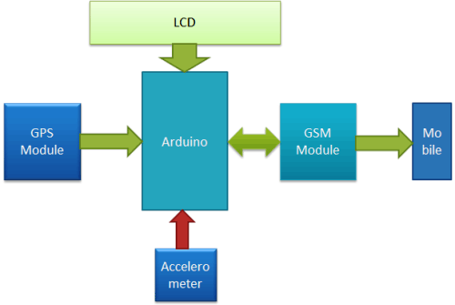
Seat belt sensor is used to detect whether the driver is wearing seat belt for not. If person is not wearing seatbelt the buzzer is turned on and message is displayed on LCD.
Accident detection and vehicle messaging system using GSM modem helps to detect accident by vibration sensor.
Vibration sensor (Piezo elements) comes in handy when you need to detect vibration or a knock. Can use these for tap or knock sensors pretty easily by reading the voltage on the output.
Vibration sensor helps to send the signal to Arduino controller. Arduino controllers send the alert message to the registered users through GSM modem with location.
If the person meets a small accident, the driver can inform attention is not required by terminating the message using switch.(push button).

Slide 7
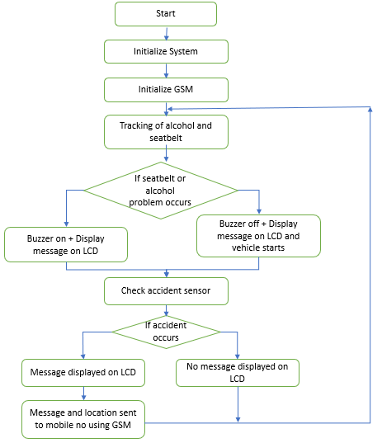
EXPECTED OUTCOME/BLOCK DIAGRAM

Slide 8
LEARNING
By the completion of the project we are expecting to learn the following:
The working of various sensors such as alcohol sensor, seatbelt sensor and accident detection sensor and how they can be used to protect the drivers.
Tracking of location of accident by GPS and how the message is conveyed to the coded number via GSM.

Slide 9
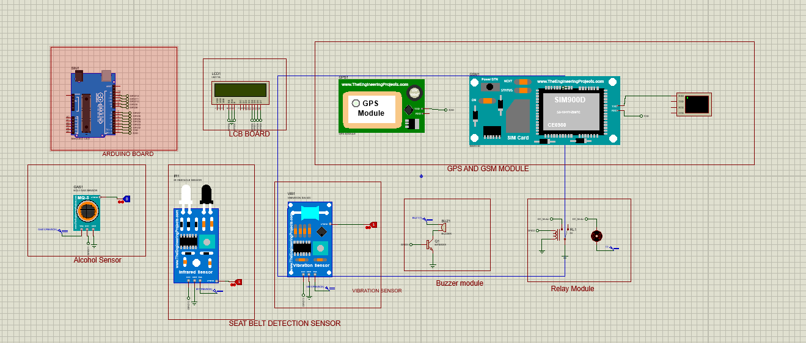
SOFTWARE IMPLEMENTATION

Slide 10
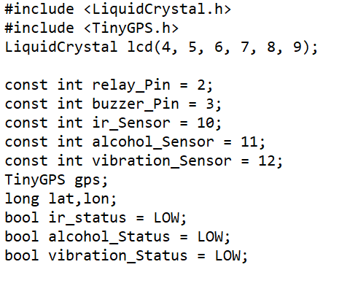
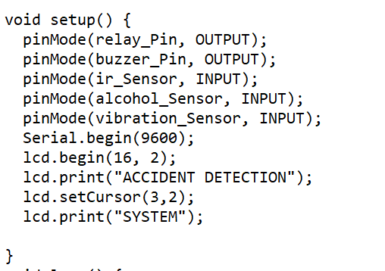
ARDUINO CODE:

Slide 11
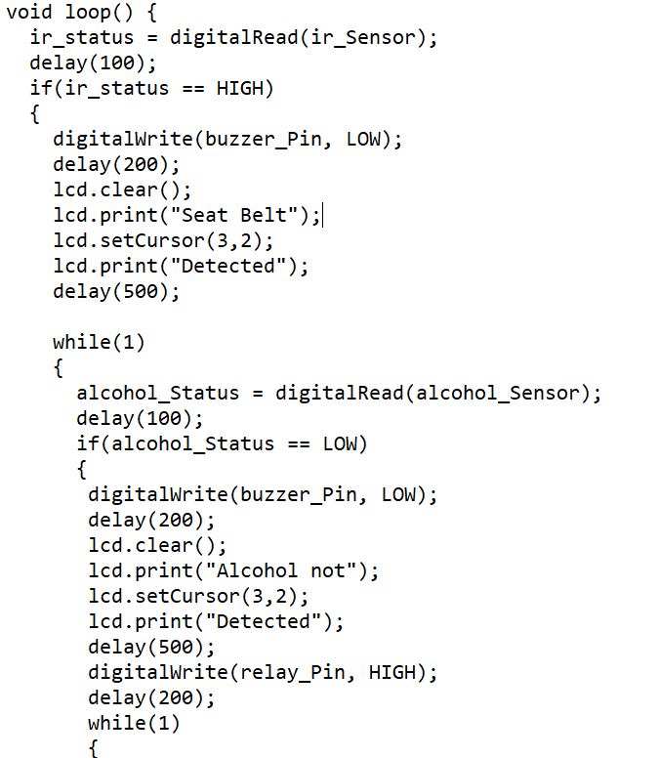
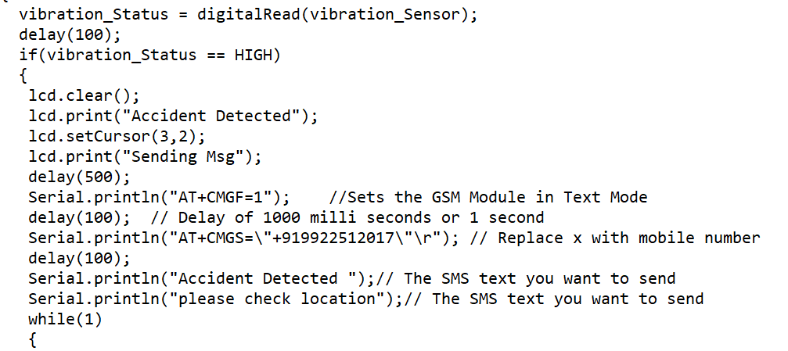
ARDUINO CODE

Slide 12
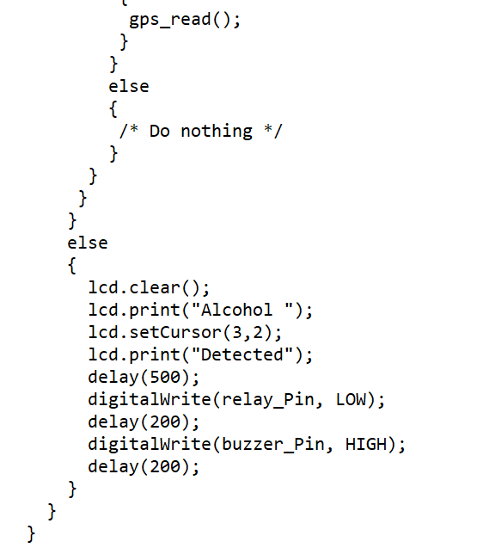
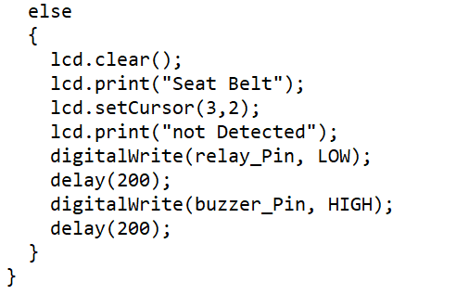
ARDUINO CODE

Slide 13
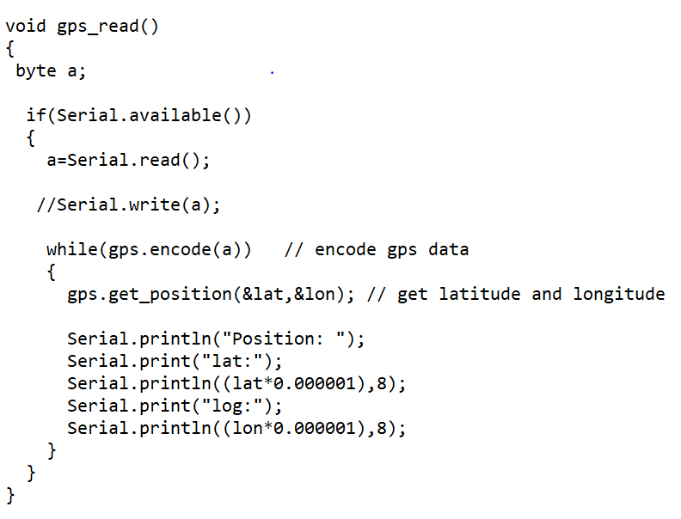
ARDUINO CODE

Slide 14
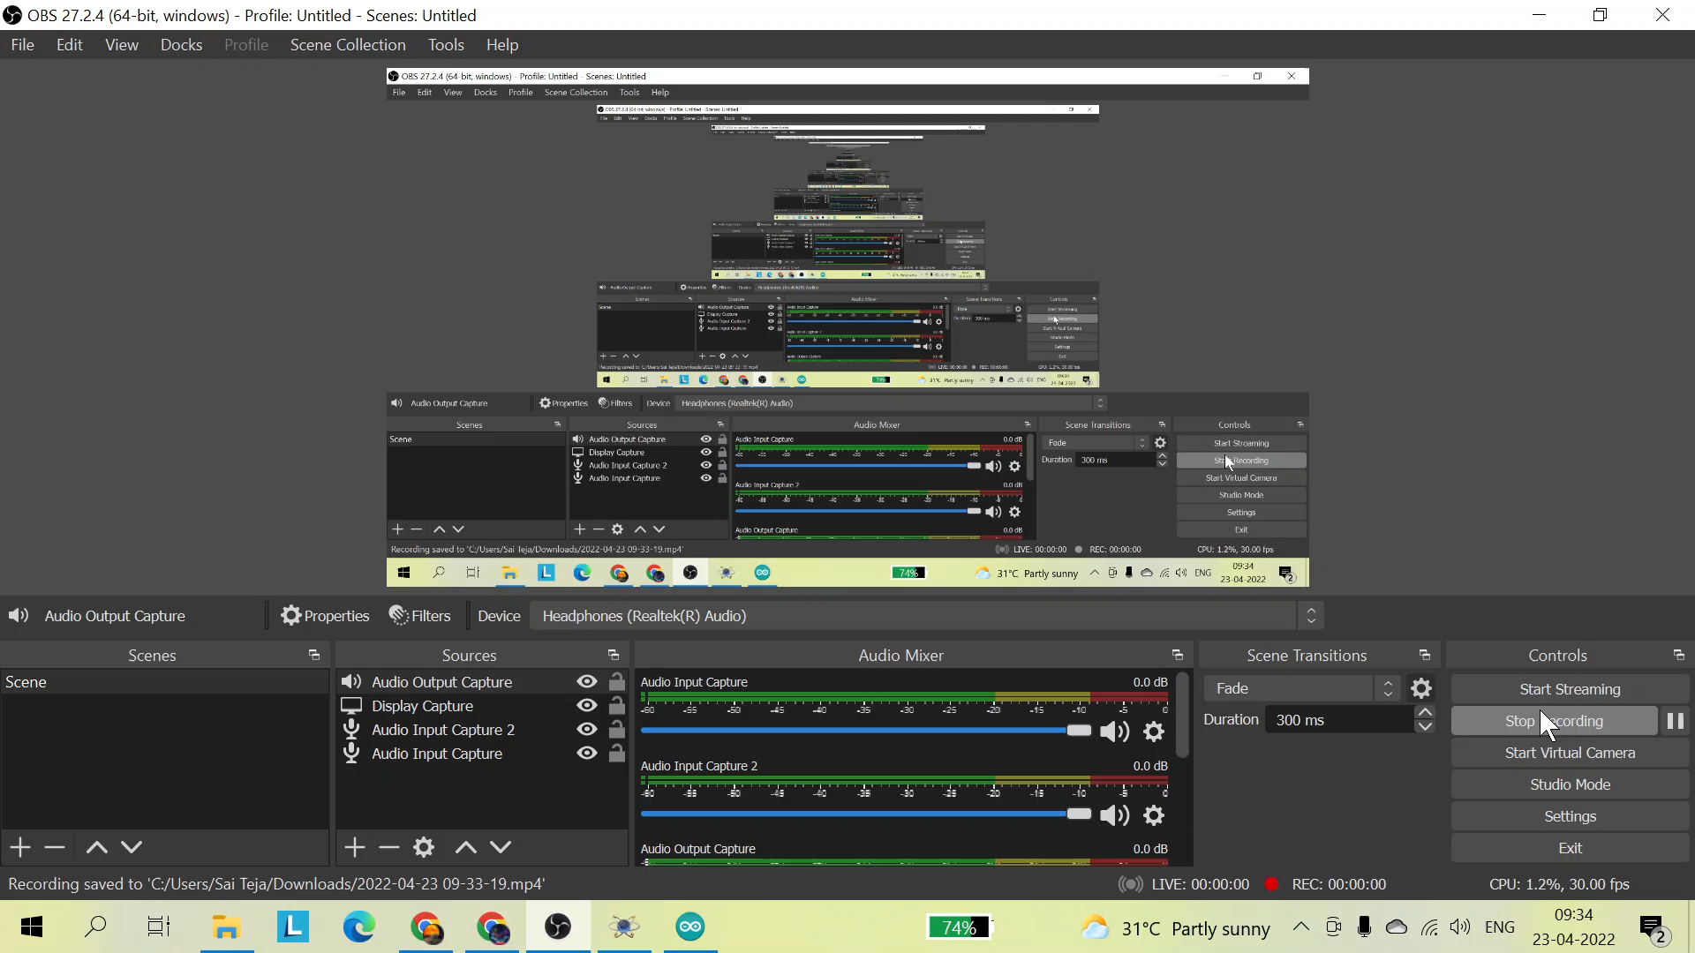
SIMULATION VIDEO

Slide 15
SOFTWARE RESULT
Initially when the seatbelt is not detected(IR sensor value is given as 0), the message “Seatbelt not detected” is displayed on the LCD Display and the buzzer starts ringing and the vehicle doesn’t move. In the next case, if the driver is wearing a seatbelt but is under the influence of alcohol(alcohol sensor is given as 1), then the message “Alcohol Detected” is displayed on the Lcd display and the vehicle doesn’t move.
In the ideal case where the driver is wearing a seatbelt and not under the influence of alcohol, the vehicle starts to move and buzzer stops ringing. In case there is any accident detected(vibration sensor is given as 1), then the vehicle stops to move and a message saying that the driver has encountered an accident is sent to the family members or registered number in the gsm module along with the location of the accident.

Slide 16
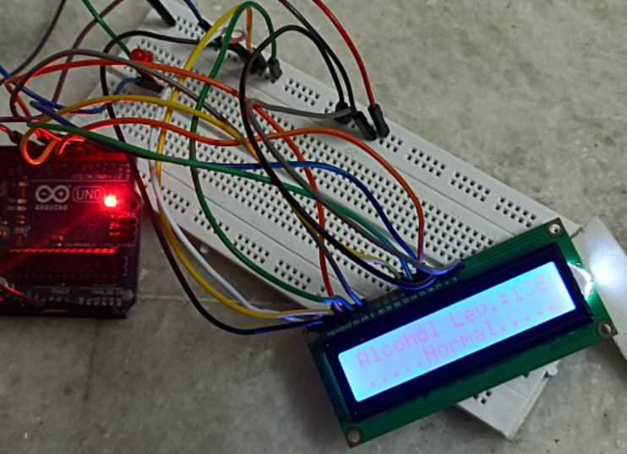
HARDWARE MODEL

Slide 17
COMPONENTS USED FOR HARDWARE
Components Required:
1. Arduino UNO Board
2. 16*2 LCD
3. MQ-135 Gas/Alcohol Sensor Module
4. LED
5. Breadboard
6. Connecting Jumper Wires

Slide 18
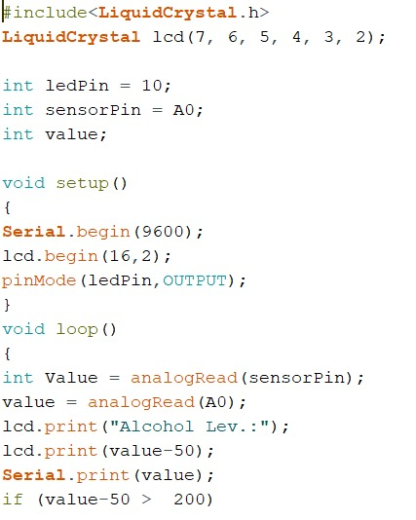
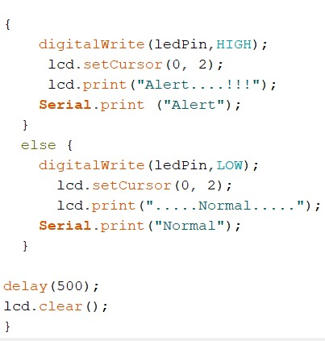
HARDWARE CODE

Slide 19
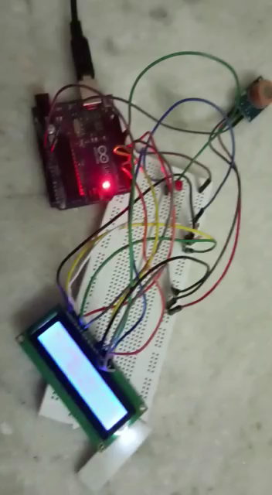
HARDWARE DEMO VIDEO

Slide 20
HARDWARE RESULT
If the alcohol sensor senses alcohol level in the driver as greater than a certain limit(400), then the led starts glowing and an alert message is printed on the lcd along with the alcohol value.
If the alcohol sensor senses alcohol level in the driver as lesser than a certain limit(400), then the led doesn’t glow and a “....Normal.…” message is printed on the lcd along with the alcohol level.

Slide 21
CONCLUSION
This project will be very useful in saving people’s lives. Since seatbelt and driving without consumption of alcohol are necessary things to be followed while driving, this can be implemented as a solution. Also notification of any accident occurred will also be helpful for people.

Slide 22
INFERENCE
We learnt the working of various sensors such as alcohol sensor, seatbelt sensor and accident detection sensor and how they can be used to protect the drivers.
We learnt how to use an arduino and how to program it to get a particular result.
We also learnt to connect different hardware components.
We learnt how an alcohol sensor works.
We also got to know how to apply different things in different fields for the use of people.

Slide 23
FUTURE WORK
In future, this can also be added with temperature sensor. Because in case there is any medical condition for any of the passengers such that the temperature of their surroundings should be in a particular range, people can adjust accordingly.

Slide 24
COST
Arduino: 500
LCD Display: 200
LED: 10
Breadboard(small): 50
MQ 3 Alcohol Sensor: 200
Jumper Wires: 100
Total: 1060

Slide 25
REFERENCES
https://www.researchgate.net/publication/324314274_Alcohol_Detection_of_Drunk_Drivers_with_Automatic_Car_Engine_Locking_System
https://www.ijert.org/automatic-engine-locking-system-through-alcohol-detection
https://www.irjet.net/archives/V6/i1/IRJET-V6I1294.pdf
https://www.youtube.com/watch?v=WuWusM4SZ1U

